Slide 1
AI-Driven Smart Hospital Patient Risk Assessment and Healthcare Analytics Platform
Logo/Content here
Machine Learning Project
KL University — Department of Artificial Intelligence & Data Science
Group Number: [GROUP NUMBER]
Team Number: [TEAM NUMBER]
Team Members:
Vadla Vishal — 2510080031
Singam Tejaswini — 2510080049
Shirisha — 2510080017
Krishna Vamshi — 2510080034
Supervisor: Dr.Gangamohan Paidi
Subject: Machine Learning
ARTIFICIAL INTELLIGENCE AND DATA SCIENCE DEPARTMENT

Slide 2
Problem Identification
WHAT IS THE PROBLEM?
WHY IS IT IMPORTANT?
WHO IS AFFECTED?
Hospitals handle large volumes of patient data, making it difficult to quickly identify disease risks, emergency severity, unusual cases, and patient patterns through manual analysis.
Timely identification of patient risks can support faster decision-making, better patient prioritisation, early risk detection, and data-driven healthcare insights.
Hospitals, doctors, emergency staff, nurses, and healthcare administrators face this challenge when analysing patient information and identifying high-risk cases. Patients are the ultimate beneficiaries of faster and better-informed healthcare decisions.
“Need: An intelligent ML-based system for faster, data-driven patient risk assessment and healthcare analytics.”

Slide 3
Need for the Project — Societal Need
WHY IS THIS PROJECT NEEDED?
WHO WILL BENEFIT?
WHAT IMPACT WILL IT HAVE?
Doctors & Nurses benefit from faster patient risk assessment and prioritisation. Emergency Staff get quicker identification of high-risk cases. Hospitals & Administrators achieve better data-driven decisions and patient insights. Patients benefit from faster and more informed healthcare decisions.
Healthcare systems generate large amounts of patient data, but analyzing it manually can be time-consuming and may delay identification of high-risk cases. An intelligent ML-based system is needed to provide faster patient risk assessment and data-driven healthcare insights.
The system can support early risk identification, faster decision-making, patient prioritisation, and efficient analysis of healthcare data. At an industry level, it demonstrates how machine learning can support scalable, data-driven healthcare services.

Slide 4


Project Objectives
To develop an intelligent machine learning platform that transforms patient health data into accurate and actionable healthcare insights.
1
2
3
4
01
02
03
04
Multi-Disease Prediction
Emergency Risk Assessment
Patient Pattern Discovery
Anomaly Detection
Predict multiple disease categories from patient health information using machine learning.
Identify unusual patient records and abnormal health patterns using Isolation Forest.
Classify patients into Low, Medium, High, and Critical severity levels.
Use K-Means clustering and PCA to identify and visualize meaningful patient groups.
5
05
Real-Time Healthcare Analytics
Deploy ML models through FastAPI and provide real-time predictions and monitoring.
From Patient Data → Intelligent Insights → Better Decision Support

Slide 5

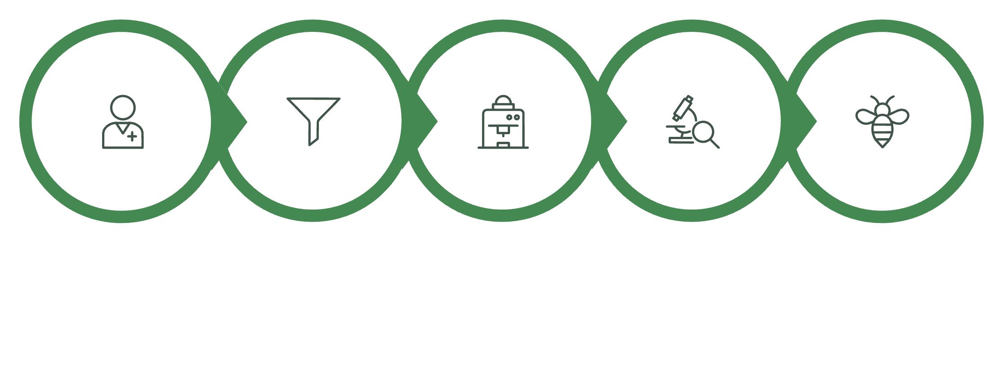

Proposed Solution & Methodology
An end-to-end ML platform that transforms patient health data into predictive and actionable healthcare insights.
The system compares multiple ML models and deploys the best-performing model based on validation performance rather than assuming a single algorithm is always optimal.
Patient Data
Data Processing
ML Prediction
Patient Analytics
Real-Time Service
Methodology Summary: Data Collection → Preprocessing → Feature Engineering → Model Training → Model Comparison → Evaluation → Deployment → Monitoring → Retraining
Core Modules
Patient Data Management
Multi-Disease Prediction
Emergency Risk Assessment
Patient Clustering & PCA Analytics
Anomaly Detection
FastAPI Prediction Service
Healthcare Analytics & Model Monitoring

Slide 6



Proposed Solution & Methodology
End-to-end machine learning pipeline for patient risk assessment, prediction, and healthcare analytics
LAYER 1 — INPUT
Methodology Summary: Collect → Clean → Engineer → Train → Evaluate → Select → Deploy → Monitor → Retrain
LAYER 3 — MACHINE LEARNING ENGINE
PATIENT HEALTH DATA
↓
Demographics
Symptoms
Vital Signs
Medical History
Laboratory Results
The system converts raw patient data into real-time predictive insights and analytics through an integrated machine learning pipeline.
1
SUPERVISED LEARNING
FASTAPI REST SERVICE
Multi-Disease Prediction
Receives patient data and returns real-time ML predictions.
↓
Multinomial Logistic Regression
Random Forest
XGBoost
2
LAYER 2 — DATA & FEATURE PIPELINE
HEALTHCARE ANALYTICS DASHBOARD
Output: Predicted Disease + Probability
DATA VALIDATION
Disease predictions
Risk levels
Patient clusters
Anomaly alerts
Model statistics
Remove duplicates
Handle missing values
Validate patient records
EMERGENCY RISK MODEL
Severity Classification
Output: LOW → MEDIUM → HIGH → CRITICAL
PREPROCESSING
UNSUPERVISED & ANOMALY ANALYTICS
3
Encoding
Standardization
Feature scaling
K-Means → Patient Segmentation
PCA → Pattern Visualization
Isolation Forest → Anomaly Detection
MONITORING & RETRAINING
Prediction performance
API latency
Data drift
Model behaviour
FEATURE ENGINEERING
Feature selection
Derived health indicators
Model-ready feature vector
↓
LAYER 4 — APPLICATION & OUTPUT
↓

Slide 7

Feasibility Analysis
Software-based ML solution using standard computing resources and open-source tools.
01 — HARDWARE
02 — SOFTWARE
03 — FEASIBILITY
Standard Laptop / Desktop
Development
Technical: Uses established ML algorithms and open-source tools.
Economic: No specialized hardware or expensive software required.
Operational: Can be developed, tested, and deployed using a standard computer.
Intel i5 / Ryzen 5 or equivalent
8 GB RAM minimum
10 GB+ available storage
Internet connection
Python
Anaconda Navigator
Jupyter Notebook
No specialized hardware required.
ML & Data
Pandas • NumPy
Scikit-learn • XGBoost
Matplotlib / Seaborn
FEASIBLE • LOW COST • SCALABLE
Deployment
FastAPI • Uvicorn
Streamlit
MLflow
Git / GitHub

Slide 8

Novelty of the Project
Distinguishing our solution from existing approaches in healthcare analytics.
01 — WHAT MAKES OUR PROJECT UNIQUE?
02 — HOW IS IT DIFFERENT FROM EXISTING SOLUTIONS?
The project delivers multi-perspective patient intelligence derived from a single patient record.
Instead of machine learning being confined to a solitary task, our system integrates:
Existing Solutions
Typically focus on single-disease prediction.
Often provide only a single model output.
Predictive and unsupervised techniques are commonly handled in isolation.
Exhibit limited integration between ML models and real-time applications.
Multi-Disease Prediction
Emergency Severity Assessment
Patient Segmentation
Anomaly Detection
Our Proposed Solution
Predicts multiple disease categories within a unified system.
Harmoniously combines supervised, unsupervised, and anomaly detection methodologies.
Generates multiple, diverse insights from each individual patient record.
Seamlessly integrates the entire ML pipeline into a real-time healthcare application.
This comprehensive approach constructs a significantly broader patient risk profile from the same underlying health data, offering a holistic view.
“From a single prediction to a complete patient intelligence profile.”

Slide 9


NEW FEATURES & IMPROVEMENTS
New Features & Improvements
Extending healthcare ML from prediction to integrated, real-time patient intelligence
Emergency Severity Assessment
Multi-Disease Prediction
Classify patients into Low, Medium, High, or Critical severity levels to support faster prioritization.
Predict the most likely disease category from multiple disease classes instead of a single disease.
Anomaly Detection
Patient Pattern Discovery
Utilise Isolation Forest to flag unusual patient records and abnormal health-data patterns for review.
Use K-Means and PCA to identify similar patient groups and reveal hidden patterns in healthcare data.
Model Monitoring
Real-Time ML Integration
Track prediction behaviour, response time, and data changes to ensure reliable operation and future improvements.
Deploy trained models through FastAPI REST APIs, enabling real-time prediction capabilities.
Key Improvement:
A single platform combines prediction, risk assessment, pattern discovery, anomaly detection, deployment, and monitoring.

